Slide 1
Convolutional Neural Networks
Parallelized
Reina Bitar, Sharif Fahes, Nour Onaissi

Slide 2

What are Convnets ?
Convolutional neural network is type of neural network which works very well in image recognition.
It recognize edges and patterns in image by using filters (kernel).
It consists of 2 level Forward and back propagation.
Forward propagation has 3 layers.
Convolution + RELU
Pooling (avg, max, or min)
Fully connected layer.
Feature
Learning
Classification

Slide 3


Slide 4
1. Convolutional Layer

Slide 5
It is the first layer to extract features from the image.
It uses specific filters (matrix of numbers) to extract specific features and detect patterns.
One or more filters moves over each part of image (convolved) to check if the feature that is meant to detect is present.
An element-wise product and sum between the filter matrix and the convolved part of the image matrix will be carried out. (Convolutional Operation)
The value resulted from convolutional operation will be high if the desired feature is presented in the convolved part of the image otherwise it will be low. (0 if not presented).

Slide 6
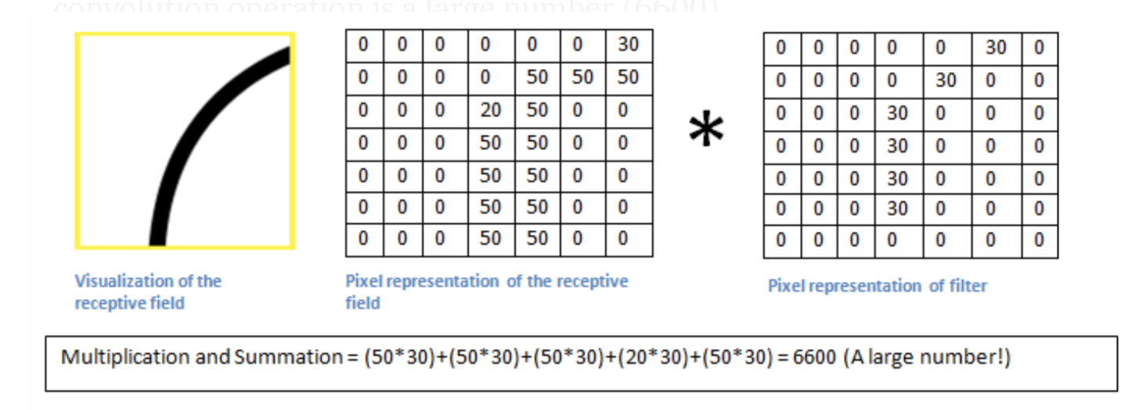
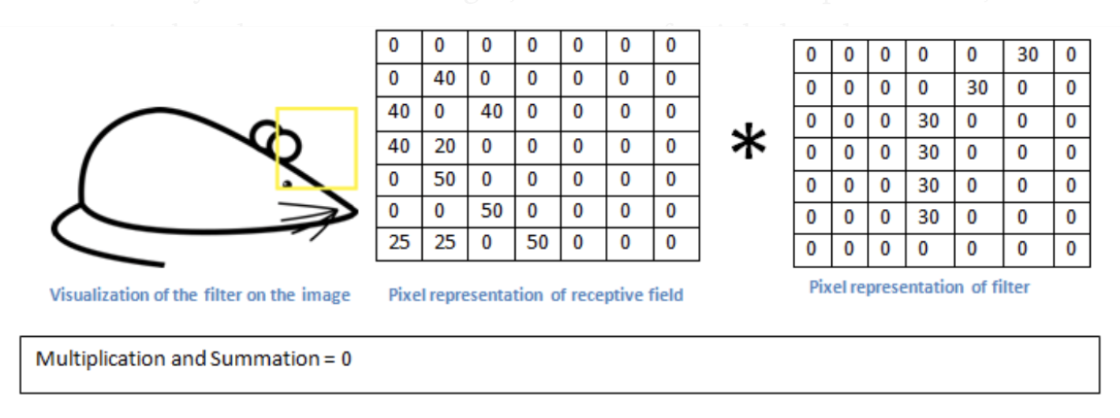
Example:
Filter to detect the right direction curves is convolving on a part of the image.
Case 1:
Right
Curve Presented
Case 2:
Right
Curve not Presented

Slide 7
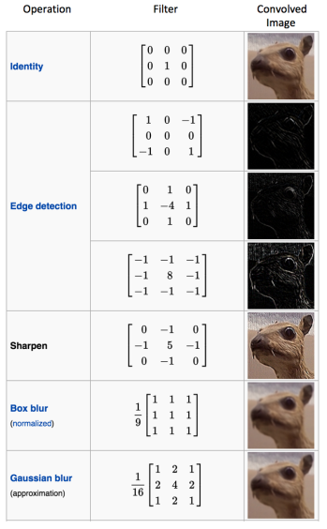
Some Filters For
Features

Slide 8
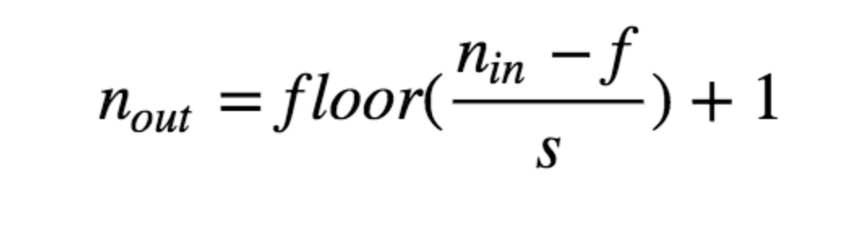
Convolving:
2d 5x5x1 Image by 3x3x1 Filter.
Stride: 1
To know the dimension of the output after the filter finishes convolving the image. We use this mathematical function

Slide 9
2. Pooling Layer (Downsampling)

Slide 10
Max pooling:
Different method can be used for pooling layer.
The purpose behind this method is to reduce the size of output in order to reduce the amount of memory used.
A window passes over an image according to set of strides. At each step the maximum value in the current window will be pooled into an output matrix.
In order to determine the dimensions of the output matrix, we use the same mathematical formula presented in the convolutional layer.

Slide 11
Example:
Window of size 2 passes over 4x4x1 image using stride s=2

Slide 12
Parallelizing Feature Learning Part
1. Convolutional Layer

Slide 13
MPI approach:
Calculate the number of rows that will be presented after convolving the image by a number of filters
Each filter will be placed as 1 channel in the output result.
Ex: If two 2x2x1 filters are convolving 5x5x1 image with stride 1.
Output will be 4x4x2 ((5-2/1) +1).
Divide the number of rows among the number of processes equally.
In the example above, each process will be responsible for 2 rows and will produce 4 elements (2 from each row).
Each process will has localConvolve array which will store its local output result and will be gathered eventually.
When the process finished from first filter it moves to the next filter if any.

Slide 14
Example
Filter of dimensions 3x3x1 convolves image of dimensions 6x6x1
in parallel

Slide 15
Parallelizing Feature Learning Part
2. Max Pooling

Slide 16
Pthreads Approach:
Take the output result dimension and calculate how many rows will be presented after it is passed into the max pooling layer.
Create number of threads equal to the calculated number of rows.
Each thread will:
Calculate the max value presented in the current window.
Store this value in the associated row.
Since each thread is responsible for 1 row, then all elements produced in thread i will be stored in pooled output in row i.
Move the window to the next column (move by stride s) to calculate the next element in row i

Slide 17
Example:
Window of size 2 passes over 4x4x1 image using stride s=2

Slide 18
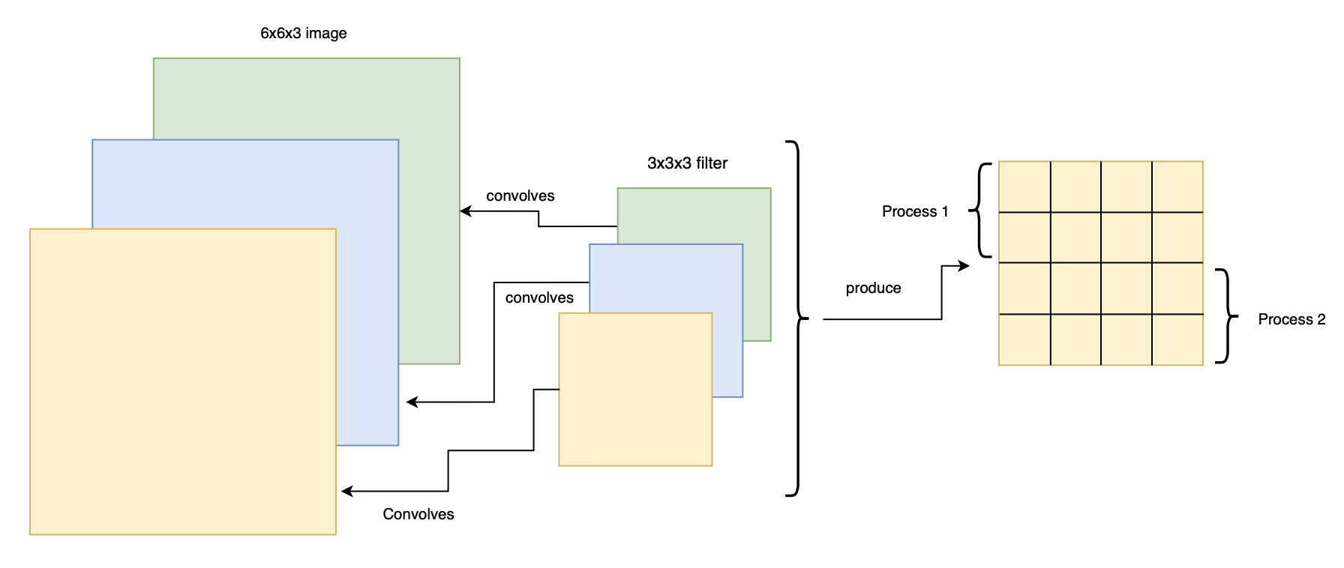
Example convolving colored image (3d matrix)
1 Filter of dimensions 3x3x3 convolves image of dimensions 6x6x3

Slide 19
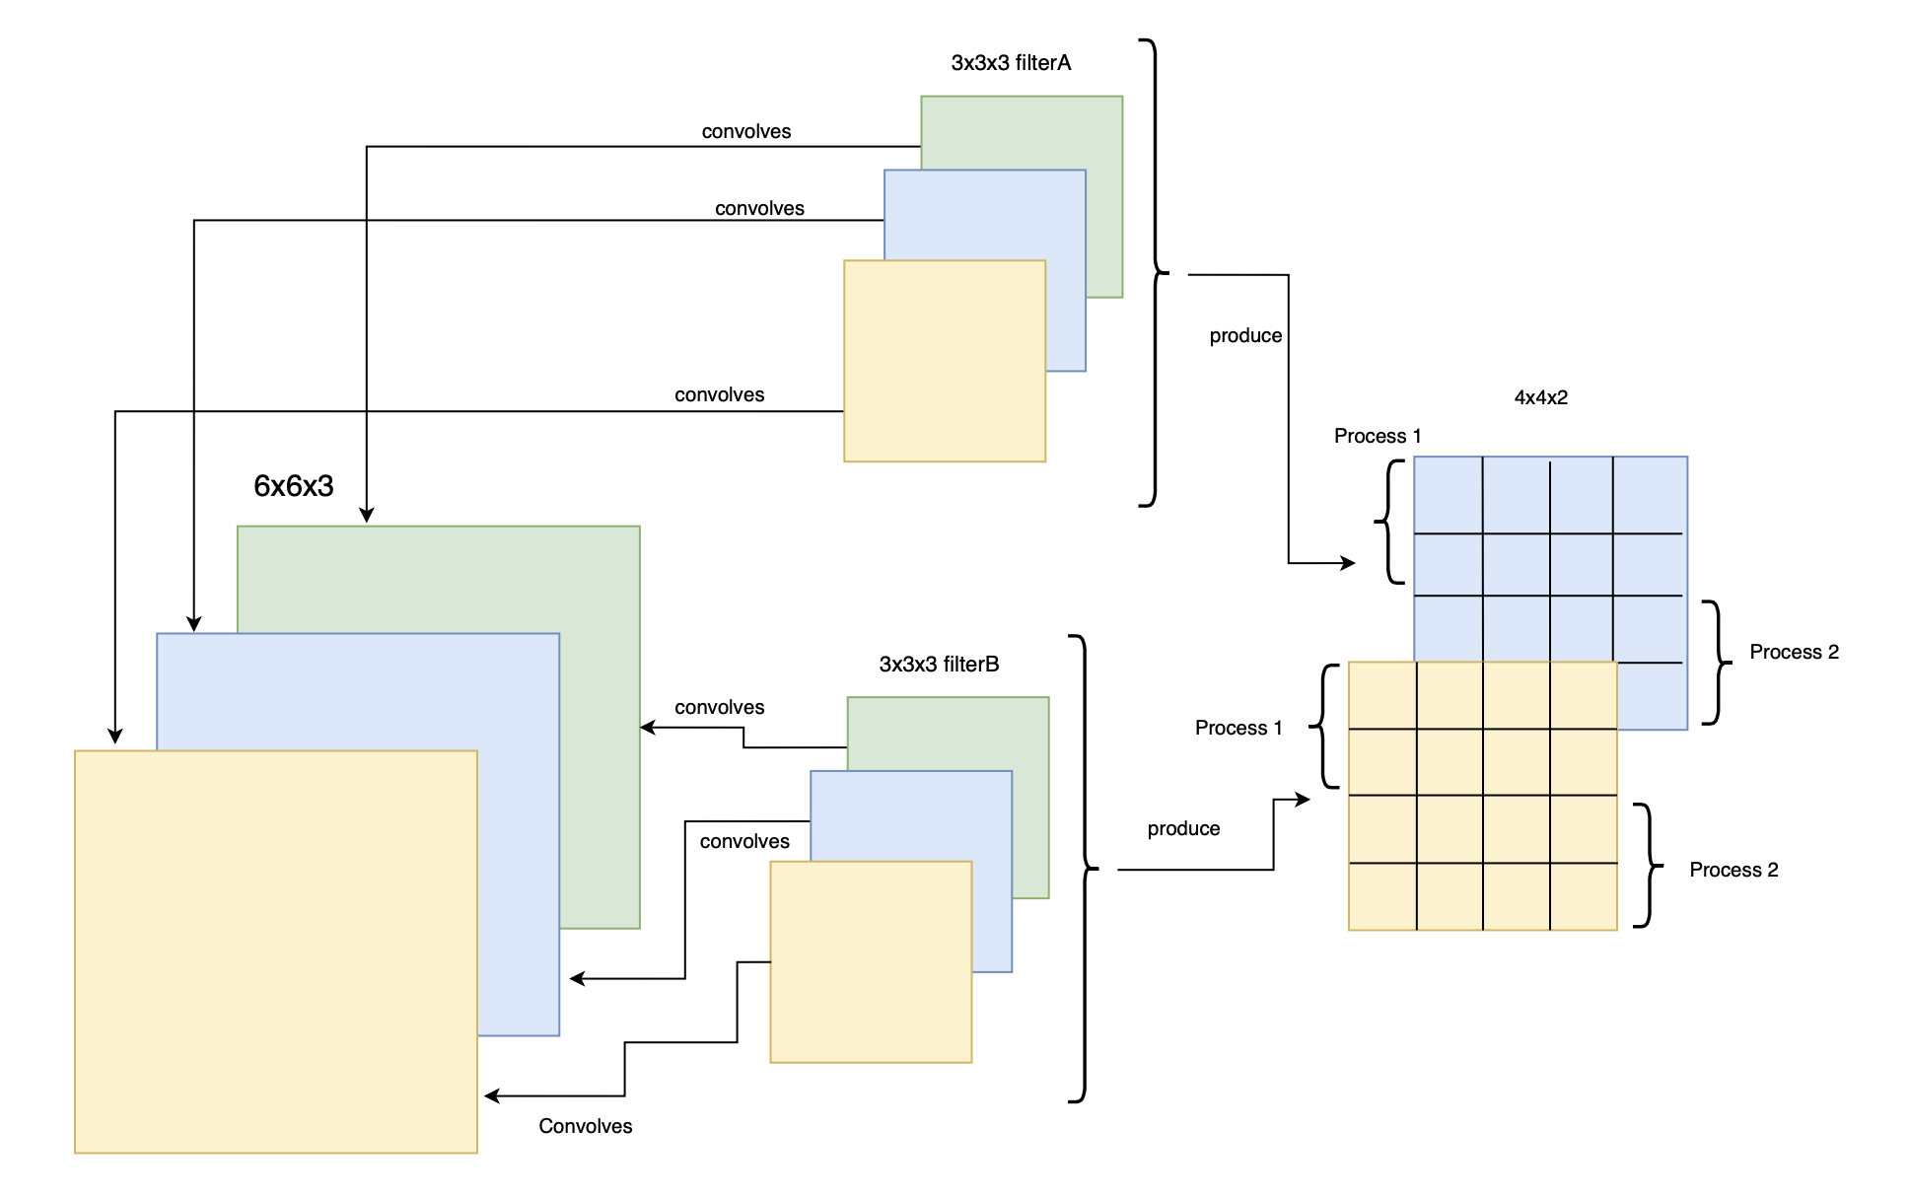
Example:
2 Filter of
dimensions 3x3x3
convolves image of dimensions 6x6x3

Slide 20
Results

Slide 21
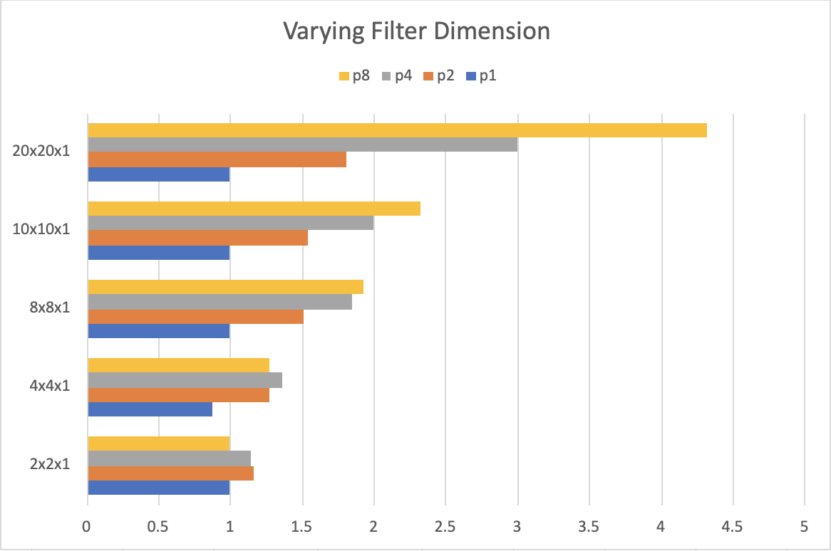
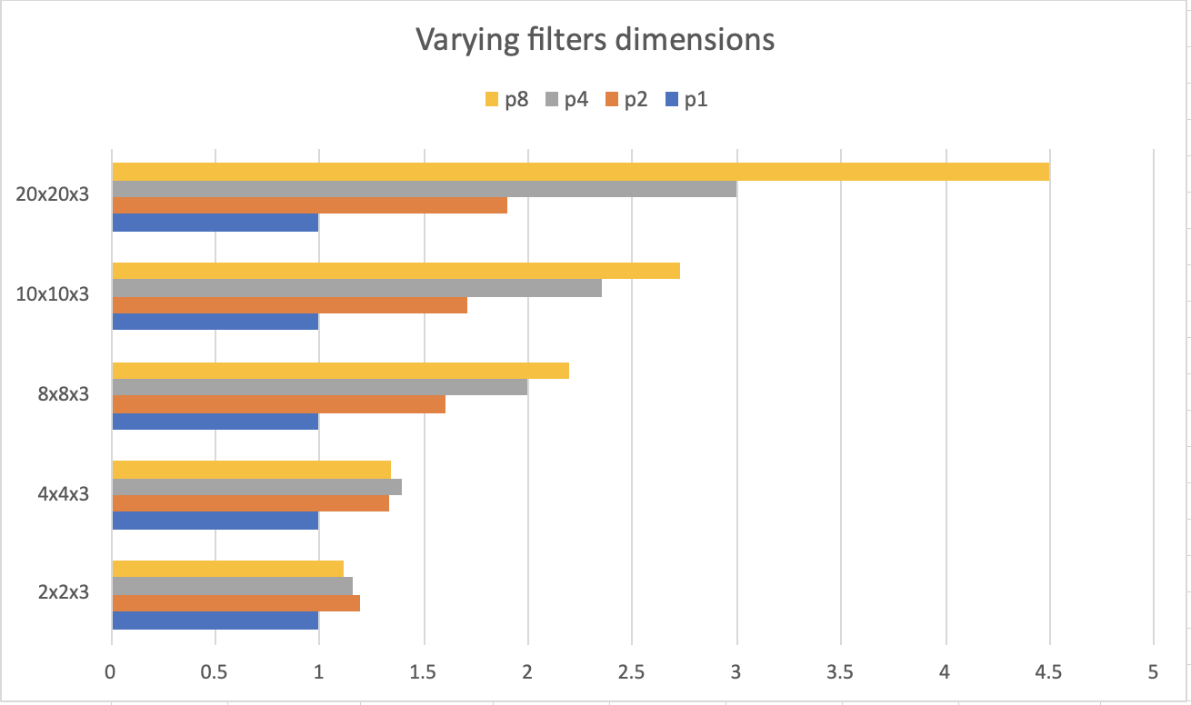
Varying Filter Dimension:
A. 1 channel:
B. 3 channel:

Slide 22
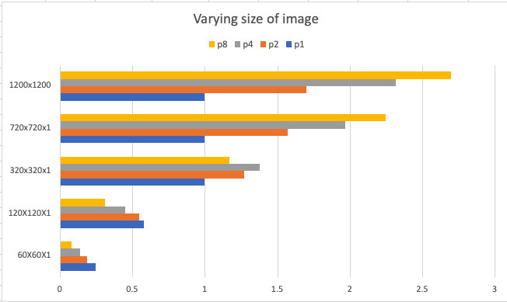
Varying Image Dimension

Slide 23
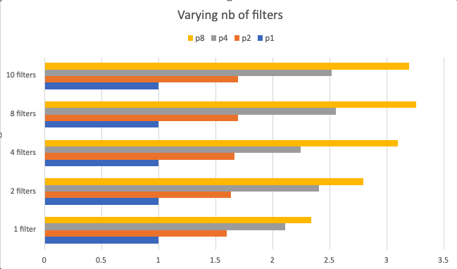
Varying number of filters

